Slide 1
A4: Concept Video
10/08
10/17
Team 2

Slide 2
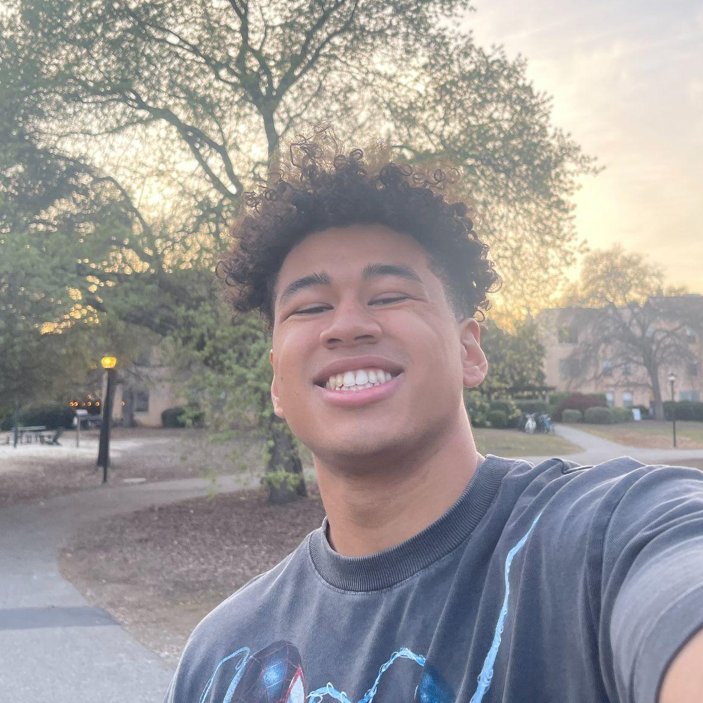
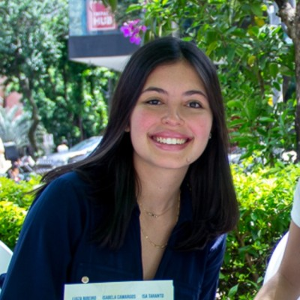
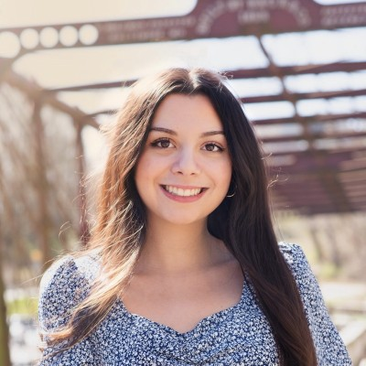
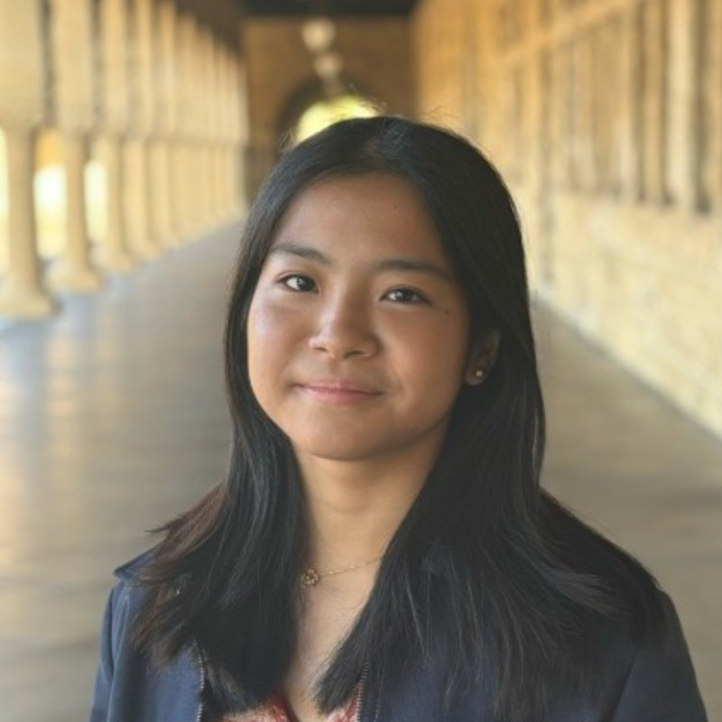
Team
Elijah
Luiza
Claire
Mikela
Symbolic Systems ‘26
Design + CS ‘28
Computer Science ‘27
Symbolic Systems ‘27

Slide 3
Index
Team 2
1
2
3
4
Project intro
Market research
Design values
Problem
5
6
7
Tasks
Storyboards
Concept video

Slide 4



Recap
Team 2
What were our solutions:
Why didn’t this work?
We were neglecting areas that repeatedly came up in our needfinding process.
Artists need more than just a digital journal because it doesn’t tackle the difficulty of organizing
A place where artists can share things that inspire them (movies, playlists, etc.) for other artists to use.
A flexible digital journal that takes multimedia inputs
An archive of past works with smart searching by medium.
Which solution did we choose:
We chose to focus on creating a flexible digital journal that takes multimedia inputs

Slide 5
Interview insights
Team 2
“I get inspired when I'm walking, and music inspires me a lot. 'Cause for me, it's about the performance, not so much the visual part.
“When I get inspired I just reach for whatever is the nearest source for me to write down how I feel”
“When I get an idea, I IMMEDIATELY go to my notes app”
Artists had different ways of finding and capturing inspiration.
“You constantly see something that is maybe worth photographing”
“It was through finding new opportunities and inspiration from peers that I explored new mediums”
"Getting inspiration from human artists is best”

Slide 6
Interview insights
Team 2
“I track ideas in notes app, but they often get scattered and hard to organize since they don’t always have context or keywords.”
“There's so much inspiration that comes throughout the day that I barely have time to capture all of it.”
“I don’t normally keep track of my inspiration or keep it in one place.”
But they had a hard time storing and organizing all of them.
“I have been having this issue where I have this photo on my phone that I just can't find it!”
"I don’t use a Pinterest board because I’m so sensation oriented.”
“A centralized hub might be a good tool.”

Slide 7
Problem space
Team 2
Artists struggle to effectively and quickly store all of their various sources of inspiration in a centralized and organized structure. This makes it harder for them to go back to these sources when they are creating art.

Slide 8
Solution
Team 2
A digital notebook that allows artists to store multimedia sources of inspiration while smarty organizing them based on their chosen categories.

Slide 9
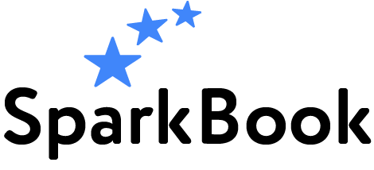
“Spark your creativity.”
How did we get our name?
The main aim of our product is to provide artists one place for all of their inspiration. This inspiration was viewed as crucial in the process of creating for every artist that we spoke to. Inspiration sparked their creativity. Thus, SparkBook was born. Our slogan “spark your creativity” is unique to our app because artists run into the problem of not being able to find inspiration or having a hard time coming back to inspiration. Our product aims to solve this problem and guarantee an artist can go back to what inspires them most.
Notes:
a. How did your team land on the name? b. One-liner value proposition that conveys what customers get out of your product (e.g., Stripe “Payment infrastructure for the Internet”) c. Sanity check: could your value proposition be applicable to many other apps or is it particular to yours? You want the latter.

Slide 10
Market research

Slide 11

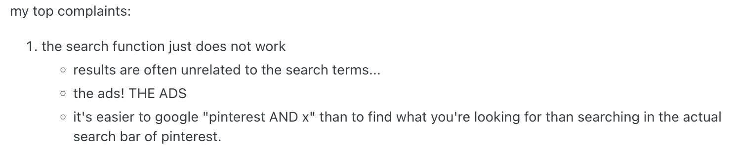
#1: Pinterest
“A discovery engine where users can find, save, and share ideas/inspiration through images onto boards”
What Works?
Accessible through mobile app/web
Ability to organize boards
Option to make activity public/private
What Doesn’t?
Searches aren’t catered to artists (flooded with ads/marketing)
Only photos
Our Unique Features
Multimedia inputs
Smart organizing of boards
AI to synthesize the board and provide relevant search results
Specific use cases to visual artists
Source: reddit
Notes:
What are some similarities and differences between the products? What has (and has not) worked for them? What makes your solution concept unique? What are the implications on your solution?

Slide 12
#1: Pinterest
“A discovery engine where users can find, save, and share ideas/inspiration through images onto boards”
Takeaway:
Artists highly value specific and catered content that is relevant to their unique art style and subject.
Notes:
What are some similarities and differences between the products? What has (and has not) worked for them? What makes your solution concept unique? What are the implications on your solution?

Slide 13

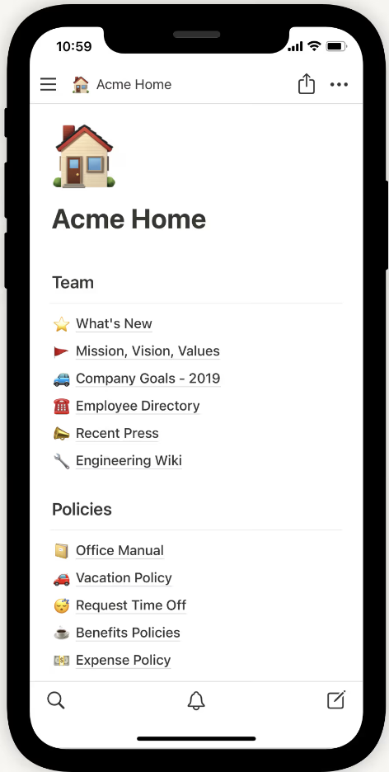
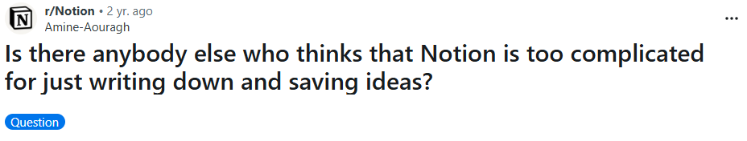
#2: Notion
“A flexible, all-in-one workspace acting as a customizable platform for organizing personal and professional life”
What Works?
Unified workspace across mediums
Customizable pages
Building blocks
Collaboration
AI tools
What Doesn’t?
Steep learning curve
No offline access
Poor mobile experience
Our Unique Features
Simple, intuitive interface
AI used for organization/ recommendations (not GenAI production)
Usable across devices
Notes:
What are some similarities and differences between the products? What has (and has not) worked for them? What makes your solution concept unique? What are the implications on your solution?

Slide 14
#2: Notion
“A flexible, all-in-one workspace acting as a customizable platform for organizing personal and professional life”
Takeaway:
Maintain customizable and collaborative tools in a multimedia unified workspace, in a way that is intuitive and easy to use
Notes:
What are some similarities and differences between the products? What has (and has not) worked for them? What makes your solution concept unique? What are the implications on your solution?

Slide 15

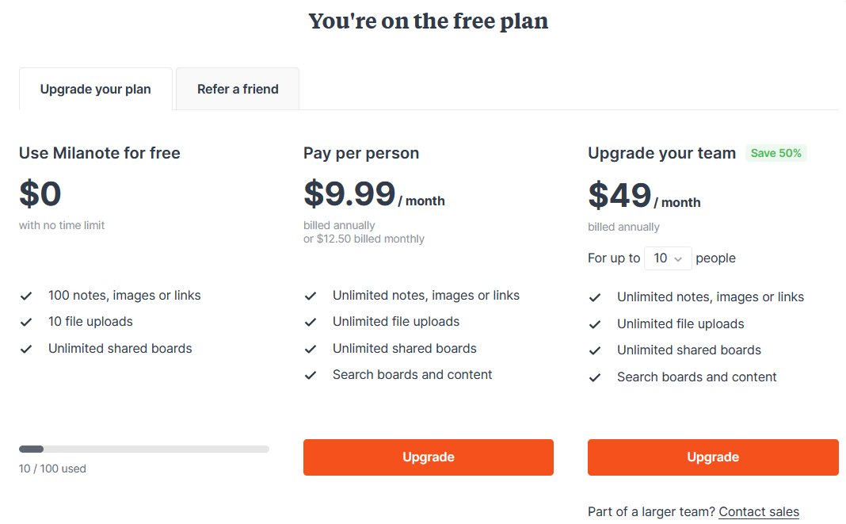
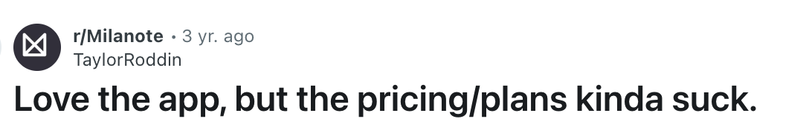
#3: Milanote
“An easy-to-use tool to organize your ideas and projects into visual boards”
What Works?
Collect various mediums in one place
Flexible drag and drop interface
Easily collaborate with other users
What Doesn’t?
Bad mobile environment
Free version is very limiting
Lack of structural tools to maintain organization
Our Unique Features
Ability to both easily input various sources and maintain and organize complex structures
Easy to use on a mobile device
Tagging features to help with categorization
Notes:
What are some similarities and differences between the products? What has (and has not) worked for them? What makes your solution concept unique? What are the implications on your solution?

Slide 16
#3: Milanote
“An easy-to-use tool to organize your ideas and projects into visual boards”
Takeaway:
Provide a visual and flexible environment that easily and automatically organizes the workplace.
Notes:
What are some similarities and differences between the products? What has (and has not) worked for them? What makes your solution concept unique? What are the implications on your solution?

Slide 17

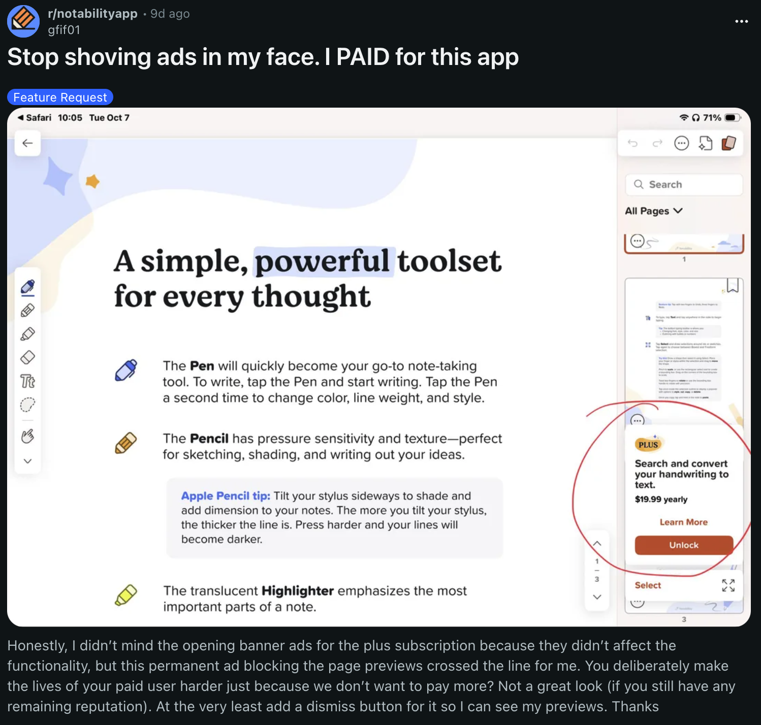
#4: Notability
“Turn your notes into knowledge”
What Works?
Handwriting easily movable
Users allowed to organize notes by topic
Allows user to create and access notes on any device
What Doesn’t?
App requires some sort of subscription
Restrictions remain unless you pay $99
Files don’t always load
Notability’s Unique Features
Syncing notebook activity with audio recording
Easily take written notes/sketches with pressure/shading ability
Searchable PDFs that read all available text
Notes:
What are some similarities and differences between the products? What has (and has not) worked for them? What makes your solution concept unique? What are the implications on your solution?

Slide 18
#3: Milanote
#4: Notability
“Turn your notes into knowledge”
Takeaway:
Provide a cloud-based workspace that lets users write by hand, move content freely, and organize notes effortlessly.
Notes:
What are some similarities and differences between the products? What has (and has not) worked for them? What makes your solution concept unique? What are the implications on your solution?

Slide 19


Competitor Comparison Matrix
Free to use |  | Freemium | Freemium
Multimedia inputs
Collaborative
AI for organization |  |  |  | Sort of (for searching)
Mobile app

Slide 20
Design Values

Slide 21
Our Stakeholders
Direct
Indirect
Primary Focus
Artists and designers
Hobbyists
Filmmakers
Writers
Photographers
Art students
Marketing teams
Artistic collaborators
Art communities
Educators
Art consumers
Tool/API integrators
Other artists (AI art scraping)
Currently designing with artists in mind as our primary stakeholder, while still considering how to create a product beneficial for all creatives.

Slide 22
Our Values
Protect artists’ creative ideas
Protect artists’ jobs
Make creativity accessible to anyone
Allow users to be flexible in their product use

Slide 23
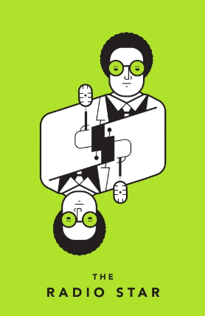
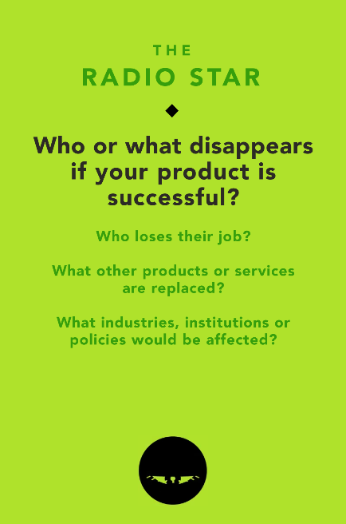
Scale and Disruption - The Radio Star
Could cause loss of admin/organizational jobs
ex) an artist’s assistant
Takes away from some of an artist’s planning time
Impacts their own job?
Could replace: Google Drive, Pinterest, Milanote, physical storyboards/notebooks

Slide 24
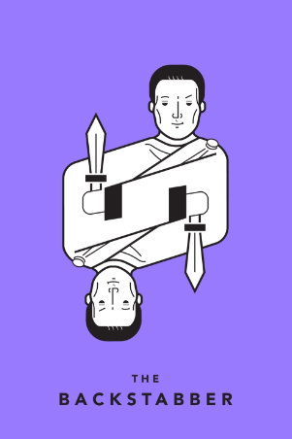
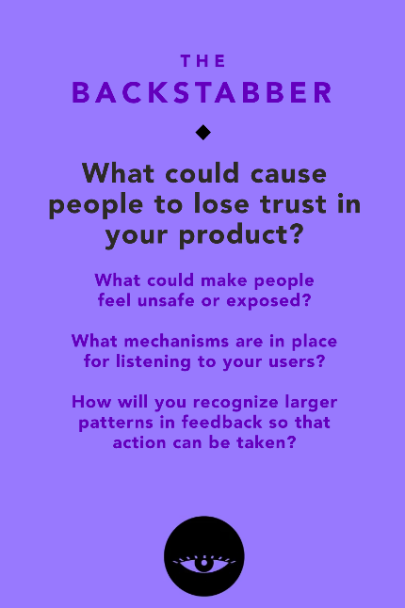
Equity and Access - The Backstabber
People could lose trust if AI learns their art and uses it to generate new art
Ask users for feedback on various features
Track which features are used most frequently
Keep true to our values and protect the artist

Slide 25

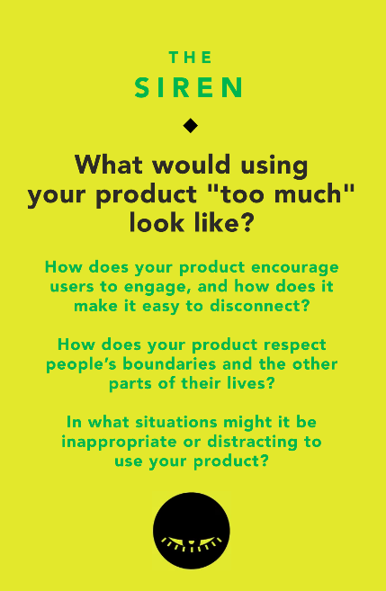
Usage - The Siren
“Too much use” could look like spending too much time planning/ organizing, not enough time creating
No ads/sponsored searches, only suggestions to help artist vision
Could be detrimental if too much “smart planning” detracts from creativity

Slide 26
Tasks

Slide 27
Tasks
Simple
Moderate
Complex
Taking pictures of a spontaneous sources of inspiration and saving it.
Task done by most users, most times they use the app
Creating a cohesive mood board of images with the creation of a specific art piece in mind.
One of the apps intended purposes, but is done less frequently than simple tasks
Compiling all the different multimedia forms of inspiration (music, notes, images, people, their own work, voice recording) in one place
How the most advanced users will use app, combines many simple and complex features

Slide 28
Storyboard

Slide 29
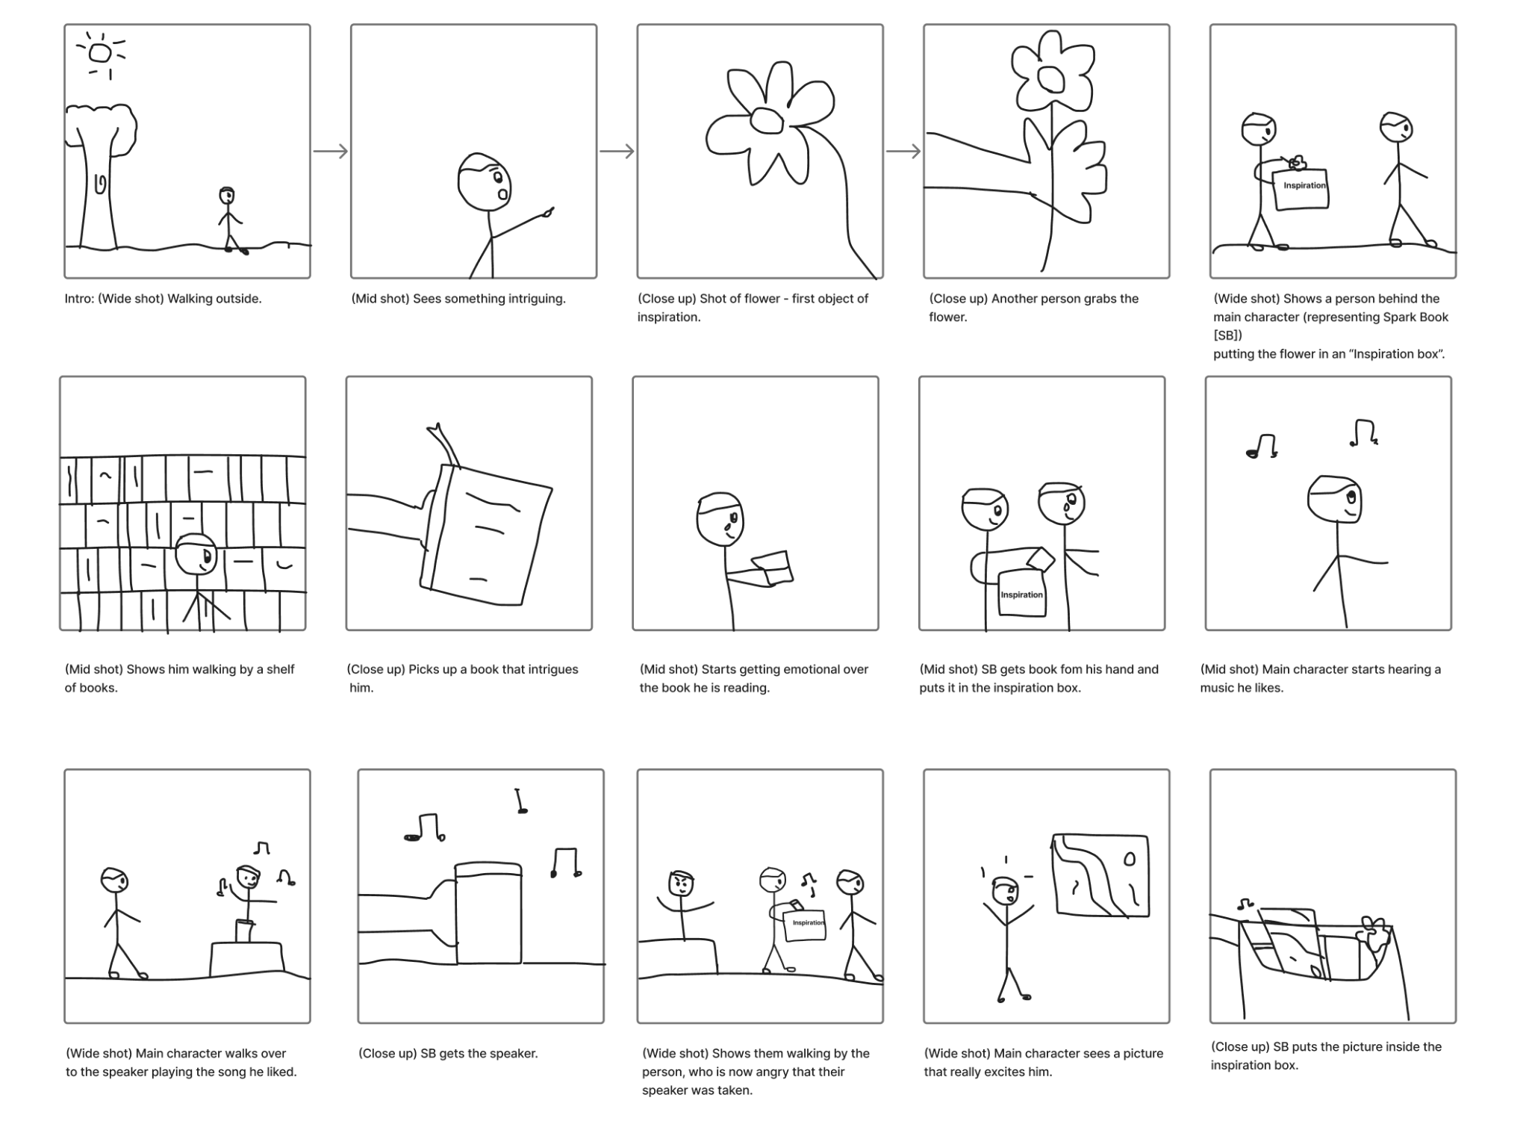
Task 1: Collecting various sources of inspiration

Slide 30
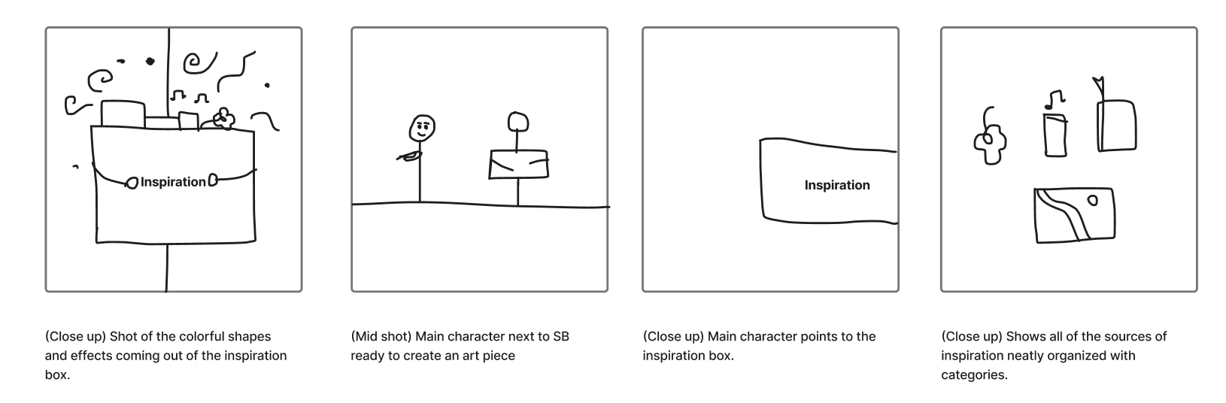
Task 2: Organizing the different sources of inspiration

Slide 31
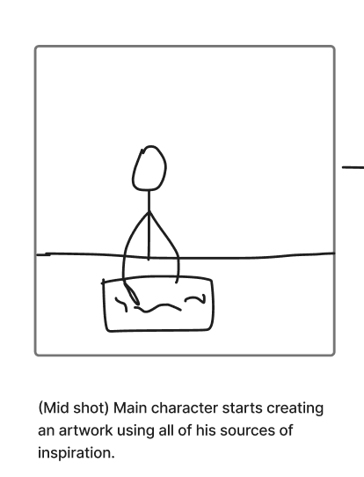
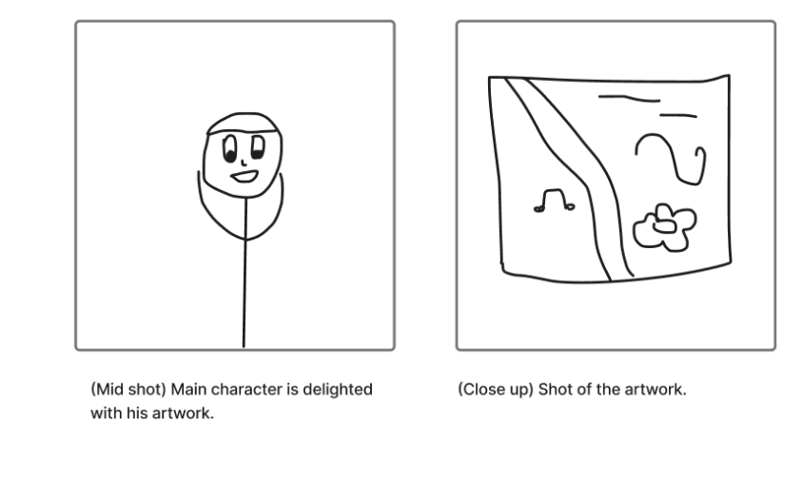
Task 3: Organizing the different sources of inspiration

Slide 32
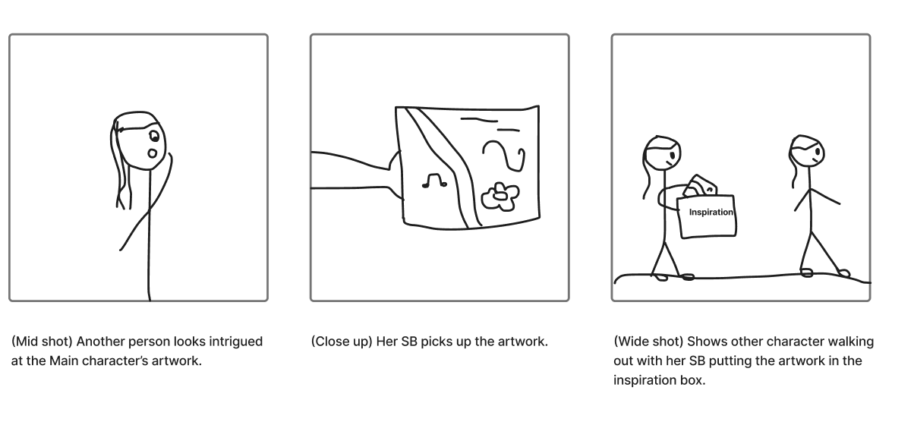
Task 4: Sharing your artwork and inspiring other artists.

Slide 33
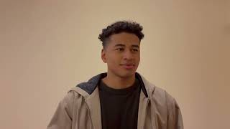
Concept Video

Slide 34
Thank you!

